Slide 1
Classification in a MLP using Minimum Error Entropy criterion
George Balas
Maria Kofterou
Anastasia Foudouli

Slide 2
Content
Goal: Develop and train an MLP Artificial Neural Network using as objective function to minimize Shannon’s Error Entropy
Define the objective function
Adapt the back propagation and gradient descent rules for the learning process
Implement the NN in Python
Train and compare the results to MLP’s using conventional Objective functions for Iris and Wine data sets
Drawbacks and discussion

Slide 3
Classification in Multilayer Perceptron (MLP)
Entropy Criteria: The minimization of the Shannon’s Entropy of the difference between the MLP output and the desired target (the error).
Idea: The minimization of error entropy implies a reduction of the expected information contained in the error, which leads to a maximization of the mutual information between the desired target and the model output. This means that the network is learning the target variable. [9]
Algorithm: Consider an MLP with one hidden layer with output y and a target variable (class membership for each example in the dataset), t.

Slide 4
Classification in MLP
For each observation we measure the error using e(n) = y(n) − t(n), n = 1, . . . ,N where N is the total number of examples.
We only consider the two-class problem; thus, as in we set t ∈ {−1, 1} and a single output unit with y ∈ [−1, 1].
These can easily be generalized in multiclass classification, by one-against-one or one-against-all classification, using a softmax activation function in the output layer.
Softmax is a generalization of the sigmoid function, that corresponds to the possibility of a sample belong to the class asigned to each neuron.

Slide 5
Activation Functions
Sigmoid function
Is used as the activation function in hidden layers. Its output corresponds to the possibility a neuron is activated or not.
Softmax function
Corresponds to the possibility a neuron is activated, given that only one among the layers of the output layer should be activated (these possibilities should sum to 1)

Slide 6
Error entropy estimator as Objective function[2][3]
The proposed back propagation algorithm uses a Shannon’s entropy estimator with mean square consistency:
This non parametric estimation for the entropy for absolutely continuous distributions proposed in [4] provides the ability to work with Shannon entropy without the computational cost of integration and the ability to estimate error distribution using Gaussian kernels
It is proven the this estimator preserves the global minimum of actual entropy[3]

Slide 7
Non paramentric kernel estimator[7]pg 483-485
E is the error random variable.
We don’t know the distribution of the error variable. For the estimation of f(x) we use the nonparametric kernel estimator:
where h is the smoothing parameter of the standard Gaussian kernel K in d dimensional space is :
As x=e(n)-e(l) and dim(e(n))= number of output layer neurons=
number of classes,
*d=number of classes

Slide 8
H(E) as an objective function
In order to ensure H(E) can be back propagated for minimization, it must be expressed as a function of weights and biases.
L=the output layer
=the activations of the neurons of l layer (a vector)
σ=the activation function of a neuron
N= the cardinality of the train set

Slide 9
How to back propagate H[1]
Back Propagation fundamental equations
1)
2)
3) ,
****Note:
Back propagation calculates the partial derivatives of H(e(x)) for every x in the train set and then

Slide 10
How to back propagate H
In order to use the steepest descent training rule and the back propagation algorithm, we need to derive an analytic expression for the gradient.
Using the usual notation where is the
partial derivative of related to the weight connecting neuron j in a previous layer to neuron k in the next layer, we have:
***Note:
The exact same
process applies for

Slide 11
Classification in MLP
Where,
Thus,
***Note: Since e(n) are vectors the differential is actually the differentiation of a matrix

Slide 12
Classification in MLP
Having determined the last expression for all network weights, the weight update is given, for the m-th iteration, by the gradient descent rule:
Where η is the learning rate.

Slide 13
Parameters
1)Smoothing parameter h:
As the training process evolves, it is expected that the errors get closer, which means that one should need a decreasing smoothing parameter h.
Experimental results led to the conclusion that this is a highly sensitive parameter.
Indeed, decreasing h as the training evolves (for example, proportional to the variance of the errors in each epoch), leads to an unstable behavior of the algorithm.
In order to cope with this instability, one should run experiments with several h values and determine the best for each dataset and network configuration.

Slide 14
Parameters
2)Learning Rate η
Idea: Adjusting η along the training process. Τhe procedure of variable learning rate not only solves the problem of choosing η, but also ensures a stable training.
An update rule for learning rate :
,restart otherwise
If entropy does not increase from one epoch to another, the algorithm is in the right direction, so η is increased by a factor u in order to speedup convergence.
If η is large enough to increase entropy, then the algorithm makes a restart step and decreases η by a factor d to ensure that entropy is being minimized.
This restart step is just a return to the weights of the previous epoch.

Slide 15
Implementation
Keras package, with Tensorflow Backend in Python
Custom loss function
MLP with1 hidden layer
Back propagation with Gradient Descent for training using “Adam” optimizer
Initial weights randomized with set.seed to obtain same results
Softmax activation functions
Gaussian smoothing parameter h=variance
Train-Test split analogy of the datasets 75%-25%
10% of the training set’s data for validation
Accuracy as Metric

Slide 16
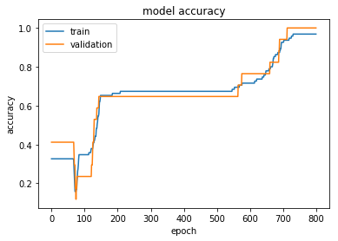
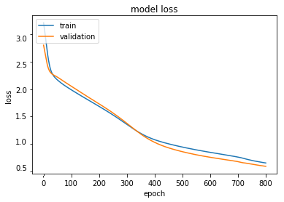
Iris Data-Optimal Model
Hidden Neurons
4
Iterations
800
Learning Rate
Execution Time
0.001
93sec
Train Accuracy
97,84%
Test Accuracy
Shannon Error Entropy
97,34%
0.82

Slide 17
Iris_Remarks
Data features were not standarized to N(0,1).
If standarized accuracy of 96% requested up to 1800 iterations
If optimizer SGD utilized, the train and test accuracy dropped to 78% and 65% for as much as 2800 iterations
If sigmoid activation function or relu was used in hidden layer’s neurons instead of softmax, train and test accuracies were as low as 86% and 84% respectively
Using more than 15 hidden neuron’s offered unnecessary complexity and over fitting .
For 4-15 hidden neurons the results remained the same
Choosing learning rate near 0.001 caused over fitting too and near 0.1 failed to find the minima
Models for comparison kept the same MLP architecture, tunned in optimal parameters

Slide 18
Iris_Comparisson
Shannon_Error
_Entropy
Train Accuracy
97,84%
Test Accuracy
97,34%
Iterations
800
Execution Time
93sec
Mean_Square_
_Error
Train Accuracy
92%
Test Accuracy
90%
Iterations
800
Execution Time
98sec
Categorical_
Crossentropy
Train Accuracy
95%
Test Accuracy
94%
Iterations
1000
Execution Time
108sec
Best MLP in bibliography [10]
Train Accuracy
99%
Test Accuracy 96,6%
Iterations 5000
Execution Time
-

Slide 19
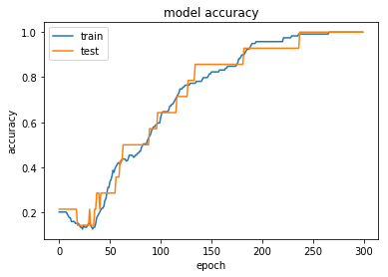
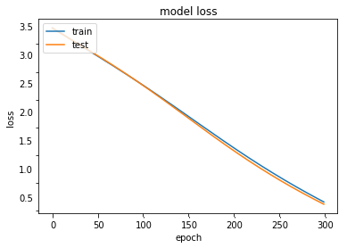
Wine Data-Optimal Model
Hidden Neurons
7
Iterations
300
Learning Rate
Execution Time
0.001
47sec
Train Accuracy
97,89%
Test Accuracy
Shannon Error Entropy
97,71%
0,68

Slide 20
Wine Data_Remarks
Data features were standarized to N(0,1). If not, MLP’s accuracy was stack to 40% even with optimal tunning
If optimizer SGD utilized, the train and test accuracy dropped to 49% and 47% for as much as 2000 iterations
If sigmoid activation function or relu was used in hidden layer’s neurons instead of softmax, train and test accuracies were as low as 36% and 26% respectively
Using more than 7 hidden neuron’s offered unnecessary complexity and over fitting
Choosing learning rate near 0.001 caused over fitting too and near 0.1 failed to find the minima
Models for comparison kept the same MLP architecture, tunned in optimal parameters

Slide 21
Wine_Comparisson
Shannon_Error
_Entropy
Train Accuracy
97,89%
Test Accuracy
97,71%
Iterations
300
Execution Time
47sec
Mean_Square_
_Error
Train Accuracy
93%
Test Accuracy
90%
Iterations
300
Execution Time
48sec
Categorical_
Crossentropy
Train Accuracy
95,2%
Test Accuracy
93,4%
Iterations
800
Execution Time
139sec
Best MLP in bibliography [11]
Train Accuracy
99%
Test Accuracy 97,6%
Iterations
---
Execution Time
-

Slide 22
From unsupervised clustering to supervised classification
We combined both methods to see if our MLP was able to achieve high classification accuracy, given the optimal clustering result using Renyi’s Clustering algorithm
Robustness to noise
Iris**Scaled
Train Accuracy:61%
Test Accuracy:53%
Wine**Standarized
Train Accuracy:94%
Test Accuracy:91.1%

Slide 23
Further Work
Applications to SVM and RDF
Test in more complex dataset like NMIST
Renyi’s Entropy instead of Shannon’s
Adjustable learning rate

Slide 24
Drawbacks
High sensitivity to h smoothing parameter, that must be estimated based on the data
MEE is proven to be harder for classification than regression [8]
Shannon’s MEE converges slower than MSE and CE, although achieving higher accuracy[6]

Slide 25
Bibliography
[1] S. Haykin, Neural Networks and Learning Machines, vol. 3. 2008.
[2] L. M. Silva, J. M. De S, and L. A. Alexandre, “Neural Network Classification using Shannon ’ s Entropy,” 2004.
[3] D. Erdogmus and J. C. Principe, “An error-entropy minimization algorithm for supervised training of nonlinear adaptive systems,” IEEE Trans. Signal Process., vol. 50, no. 7, pp. 1780–1786, 2002.
[4] I. A. Ahmad and P.-E. Lin, “A nonparametric estimation of the entropy for absolutely continuous distributions,” in IEEE Transactions on Information Theory, 1976, vol. 58, pp. 372–375.
[5] J. M. Santos, L. A. Alexandre, and J. M. De Sá, “The Error Entropy Minimization Algorithm for Neural Network Classification,” no. Mi.
[6] H. Aly, K. Rady, E. S. Academy, E. S. Cairo, P. O. Box, and E. Shorouk, “Shannon Entropy and Mean Square Errors for speeding the convergence of Multilayer Neural Networks : A comparative approach,” Egypt. Informatics J., vol. 12, no. 3, pp. 197–209, 2011.
[7] J. C. Principe, Information Theoretic Learning: Renyi’s Entropy and Kernel Perspectives, no. XIV. 2010.
[8] J. P. M. De Sá, L. M. A. Silva, J. M. F. Santos, and L. A. Alexandre, SCI 420 - Minimum Error Entropy Classification. .
[9] D. Erdogmus and J. Principe, Comparison Of Entropy And Mean Square Error Criteria In Adaptive System Training Using Higher Order Statistics. 2000.
[10] Swain M, Dash S, Dash K, Mohapatra S. An approach for Iris plant classification Using neural Network, International Journal on Soft Computing ( IJSC ), 2012

